Slide 1
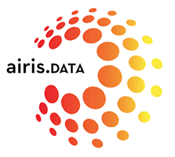
Introduction to Kubernetes

Slide 2
Agenda
Advantages/Disadvantages of Kubernetes
High Level Application Development Cycle
Kubernetes architecture
Brief overview of build in K8S objects
Demo

Slide 3
What is Kubernetes
Kubernetes is a container management Platform
Created by Google
Written in GoLang (aka Go)
Also known as K8S
Kubernetes can be loosely thought of as an operating system for managing real world distributed applications (aka microservices).

Slide 4
Services provided by Kubernetes
Fault Tolerant & ability to harness maximum resource utilization
Self Healing (via health / readiness probes)
Service discovery and service registry (via k8s services)
Auto scaling - (instance and node based scaling based on CPU, memory or custom user defined metrics)
Support for stateless, stateful applications (via stateful sets), daemon sets, Jobs, Cron Jobs etc.
Build in config maps, secrets for application configuration management.
Supports Role Based Access Control (roles, service accounts based on cluster and namespace level)
Minimal coupling with cloud provider and specifications are defined via vendor neutral Cloud Native Computing Foundation
Advanced scheduling – (Resource limits, Node affinity, taints, tolerations, disruptions etc.)
Extensible API via custom resource definitions and custom controllers.
Production ready k8s operators for custom application requirements (https://operatorhub.io)
Enables fast CI/CD pipelines

Slide 5
Services NOT provided by Kubernetes
Distributed Fault Tolerant Persistence Provisioning (alternatives – glusterFs, Ceph or cloud provider supported persistence)
External Load Balancers (alternatives – cloud provider load balancers, metalLB )
Pub-Sub functionality (alternatives – Kafka, Rabbit-MQ, cloud provider MQ ). Broadcasting messages to all pods is not yet supported in k8s.
Complex deployment orchestration (alternatives – helm, kustomize etc)
Log Aggregation and log forwarding (alternatives – ELK, Fluentd, Fluentbit(EFK) etc)
Application metrics (alternatives – promotheus, influxDB, openTSDB, Grafana, Kibana)
Tracing (alternatives – open tracing implementations like jaeger, Zipkin etc. backed by optional persistent store)
Configuration versioning. (alternatives – Netflix archaius, spring boot config server - no widely accepted standard)
CI / CD Pipelines (alternatives – JenkinsX, GoCD, Spinnaker etc)
Setting up a production K8S cluster is non-trivial and K8S can be configured with various pluggable network, storage, load balancing settings. Various commercial k8s distributions like Openshift, Rancher OS etc. are available for enterprise customers.

Slide 6
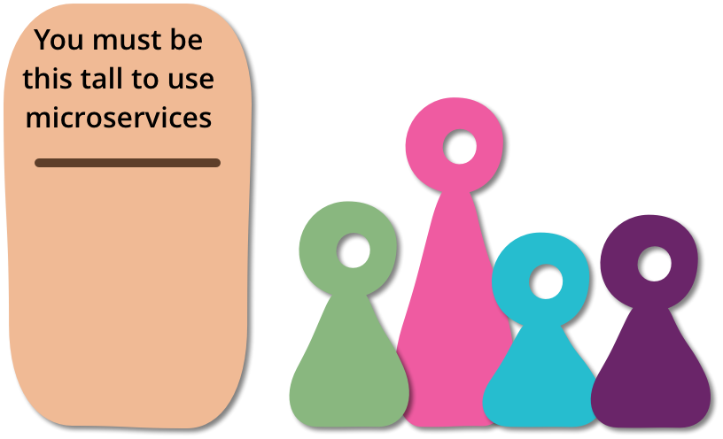
You must be this tall to use microservices
“ In particular with microservices there are serious consequences for operations, who now have to handle an ecosystem of small services rather than a single, well-defined monolith. “
- Martin Fowler

Slide 7
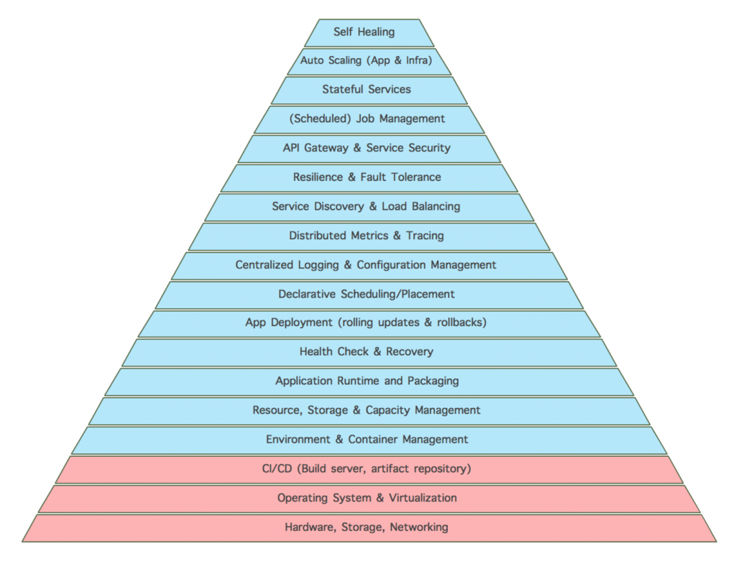
Microservices Hierarchy of Needs

Slide 8
Practical Challenges Adopting Kubernetes
Significant hardware requirements in production - (3 masters, n workers). Master should generally not be deployable node for load intensive application pods. Ideal for shared application deployment environment (i.e. cloud).
Application architecture needs to be reimplemented such that parts of the application which need to scale should be stateless and for stateful application components intermitted application state must be regained during startup or during recovery after failure. (CQRS based frameworks like Lagom, Axon etc).
May require you to switch to other languages – like Node, Golang, Rust etc. which provide fast startup times and in some cases less order of magnitude difference in terms of memory footprint than Java or any other language. Picking the right programming language for business use case can impact product overall cost of operation.
Traditional centralized SQL databases may not be ideal fit to be deployed inside k8s cluster as k8s cluster node are assumed to be ephemeral. Distributed databases can be deployed as stateful sets but they may only support eventual consistency. (Brewer’s CAP Theorem)
Distributed transactions require complex software abstractions like orchestrators or sequence of compensating actions aka choreography. (Saga Design Pattern).
Debugging distributed application remains challenging and may lead to non reproducible anomalies – so extensive UAT becomes very important before using k8s deployed applications for critical business functionality.
Changes in application development methodology – applications need to be designed to be:
idempotent – application need to handle the case when same request can be received twice.
Fault tolerant – e.g. automatic back-off retry mechanisms, thundering head issues, circuit breakers, rate limiters etc.
Expose health checks, follow structured logging patterns, instrumented for tracing, metrics.
optimized to use tiered hardware resources to achieve maximum utilization.
12-factor apps for portability and easy cloud deployment
Select a micro services framework ( Springboot, micronaut for Java, go-kit, go-micro for Golang etc)
Moving to cloud requires a shift away from traditional software development practices and a careful ROI must be realized before moving legacy applications to k8s.

Slide 9
High Level Application Development Workflow
(1) Push Image to image Registry
(2) Submit desired state via command line
(3) k8s scheduler allocate resources and sends deployment instructions to node kubelet
(4) Kubelet orchestrate container runtime (docker) to pull required image and run it on the node

Slide 10
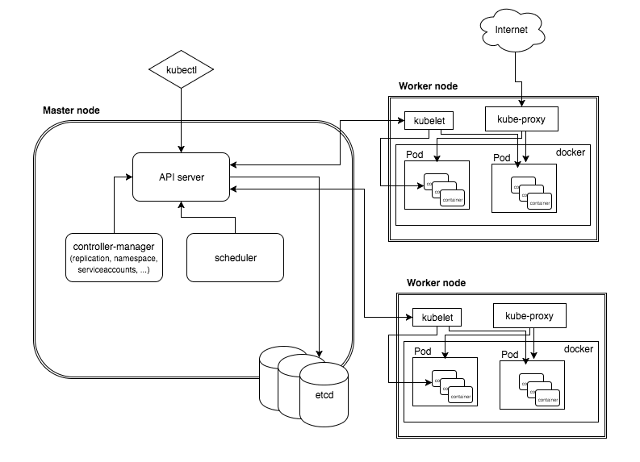
Kubernetes Architecture Overview
Kubectl – command line tool to interact with K8s API server
Kube-proxy – provides network services, load balancing, etc.
API server accepts user input, update state inside etcd cluster and emits events for changes
Controllers listening for events from API server
Container runtime manager
All state is kept inside distributed etcd cluster and only API server directly communicates with etcd.

Slide 11
Kubernetes build in Objects Overview

Slide 12
Kubernetes PODs Overview
POD is a group of one or more containers (such as Docker containers), with shared storage/network, and a specification for how to run the containers.
POD can be tagged with one or mode labels (key/value pairs)
Smallest unit to scale the application functionality – so pods are generally decide the bounded context for your microservices.

Slide 13
Replication Controllers/Replica Sets Overview
A RC or RS is a Kubernetes resource that ensures its pods are always kept running. If the pod disappears for any reason, such as in the event of a node disappearing from the cluster or because the pod was evicted from the node, the RC notices the missing pod and creates a replacement pod.
RC/RS can be configured to target POD labels conditions and then maintain desired number of replicas.

Slide 14
Kubernetes Services Overview
K8s service provides a single, constant point of entry to a group of pods providing the same service. Each service has an IP address and port that never change while the service exists.
Clients open connections to service IP and port, and those connections are then routed to one of the pods backing that service. This way, clients of a service don’t need to know the location of individual pods providing the service, allowing those pods to be moved around the cluster at any time.
Deployment of pods inside K8S automatically registers those pods inside K8S (Service Registration) and K8S services provide a way to discover the backing PODs via logical POD labels (Service Discovery)

Slide 15
Basic Types of Kubernetes Services
ClusterIP: Expose endpoints to other PODS inside same k8s cluster
NodePort: Expose endpoints to other boxes which are outside k8s cluster but within same network.
LoadBalancer: Expose endpoints to external world (e.g. internet) or whatever you defined in your LB.

Slide 16
Deployment Overview
A Deployment controller provides declarative updates for Pods and Replica Sets.
You describe a desired state in a Deployment object, and the Deployment controller changes the actual state to the desired state at a controlled rate.
Supports updating, rolling back previous deployment revisions

Slide 17

Demo
Explore Kubernetes cluster nodes
Explore Kubernetes Namespaces
Explore Kubernetes kube-system namespace
Demo Application
FrontendPod -1
BackendPod - 1
Load Balancer Service
Node Port Service
FrontendPod -2
BackendPod - 2

